Slide 1
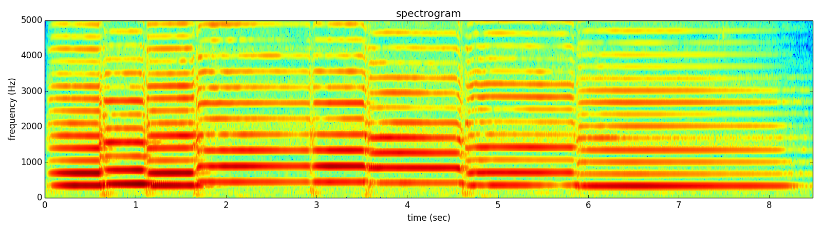
Notes:
Let me show you an example of the more practical things that we will learn to do using the software to be developed and used in the course.
This is the spectrogram of a sound I played in my cello.

Slide 2
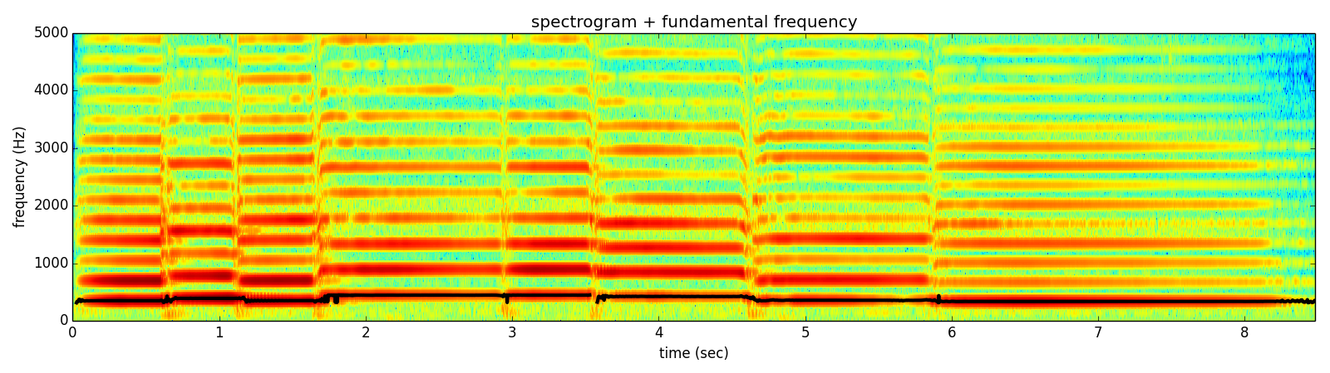
Notes:
From the spectrum we can identify the fundamental frequency of the sound, which can be synthesized as a sinewave.

Slide 3
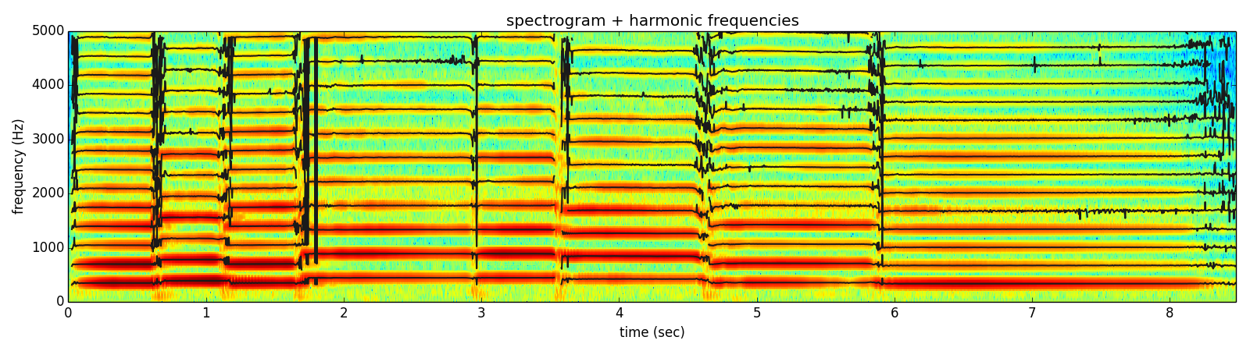
Notes:
We can then detect the harmonics of that fundamental frequency.
But there is more to the sound than just the harmonics.

Slide 4
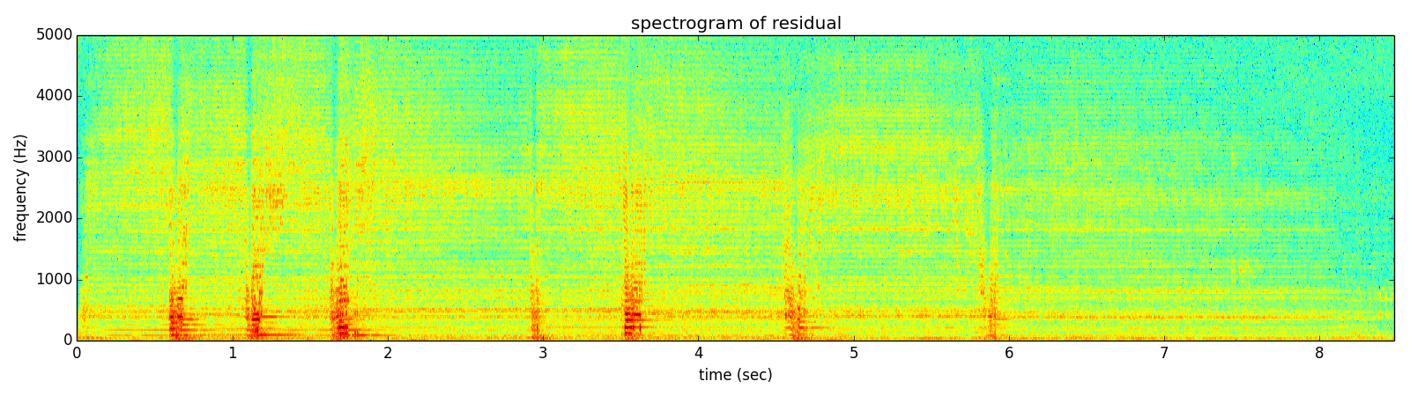
Notes:
If we subtract them from the original sound we can get the spectrum of what is left, and listen to it.

Slide 5
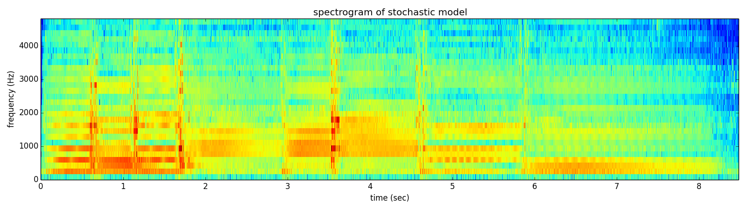
Notes:
This residual signal can be approximated with an stochastic model,

Slide 6
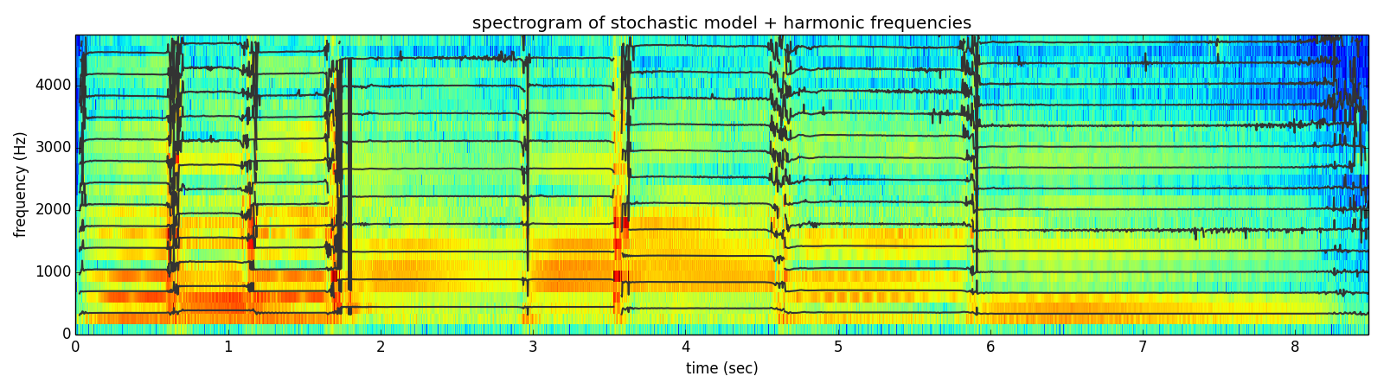
Notes:
and we can put it together with the harmonics to obtain a representation with which we can do many things,

Slide 7
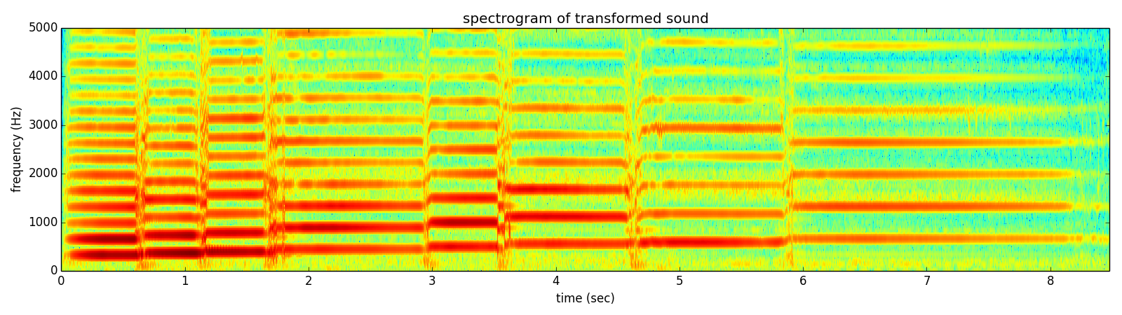
Notes:
like synthesizing a sound with the notes changed,

Slide 8
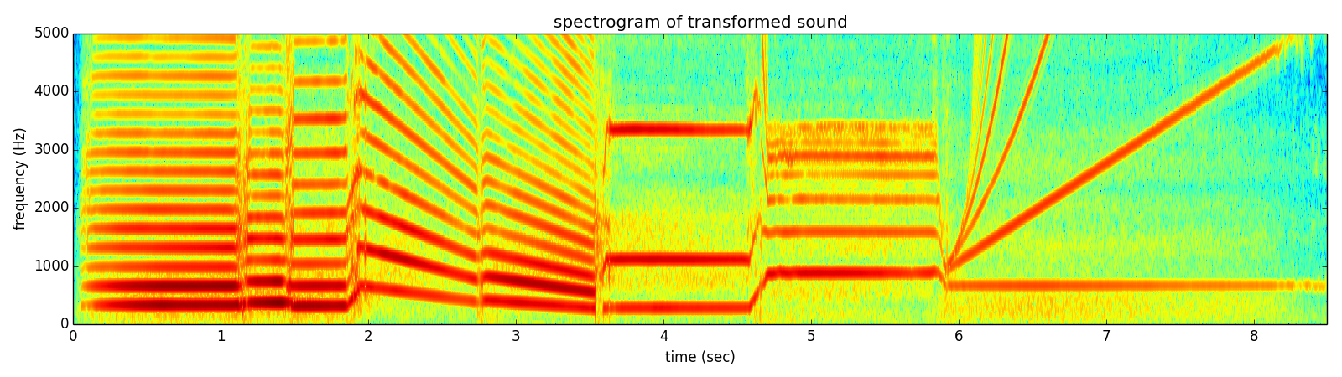
Notes:
or we can generate some weird sound like this one,
The number of possible transformations is infinite; only bounded by your own creativity.

Slide 9
Notes:
The number of possible transformations is infinite; only bounded by your creativity.

